Slide 1
How to make good charts and graphs

Slide 2

About myself
Hans-Jörg Schulz
Assoc. Professor @ CS Department, UBI Group
15+ years of experience in visualization gathered at
University of Rostock, Germany
TU Graz, Austria
University of Calgary, Canada
Fraunhofer IGD, Germany
IBM Visual Communications Lab, USA

Slide 3
Why to visualize data?

Slide 4
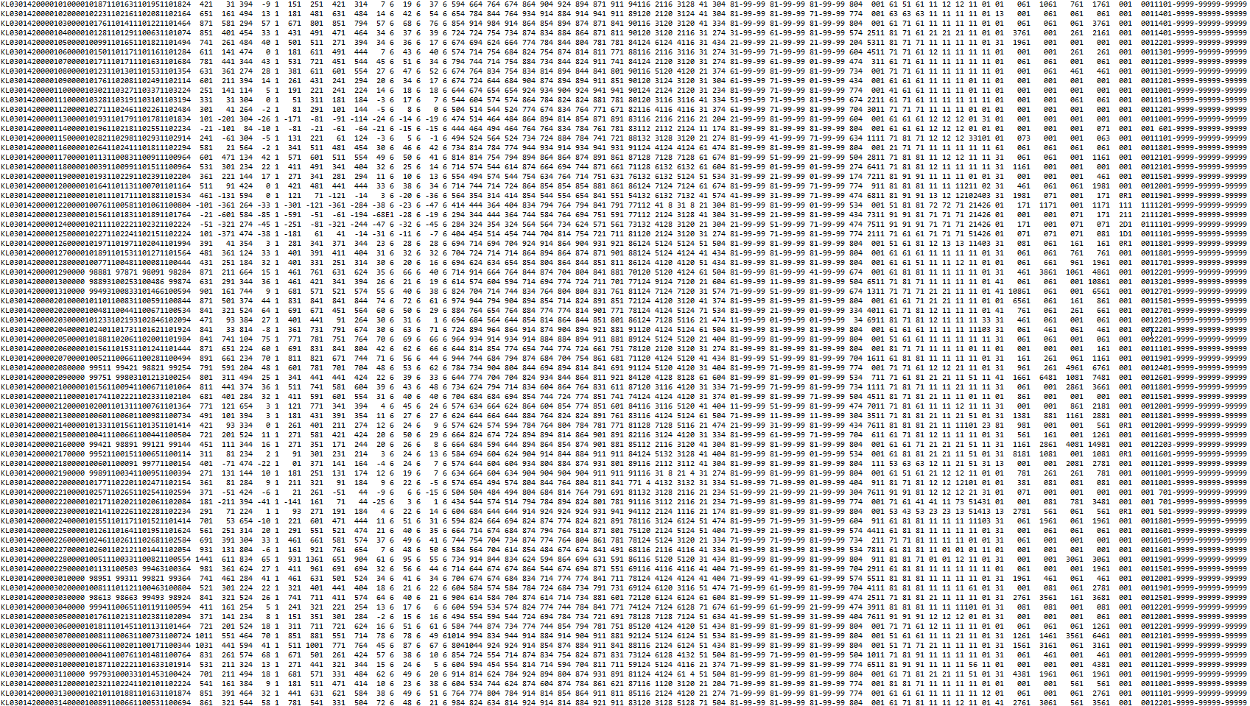
ftp://ftp-cdc.dwd.de/climate_environment/CDC/observations_germany/climate/subdaily/standard_format/kl_10170_00_akt.txt

Slide 5
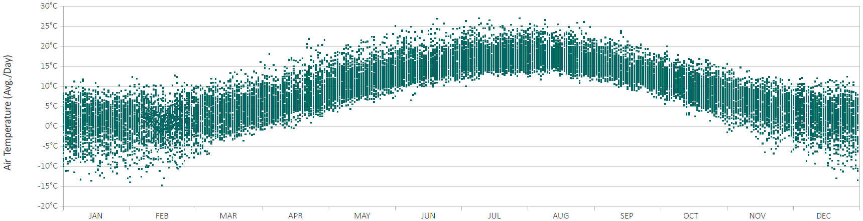
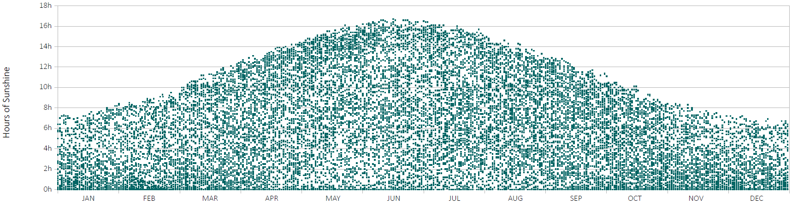

Slide 6
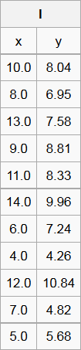
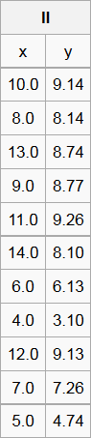
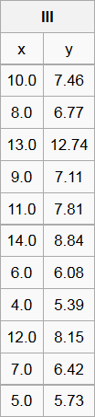
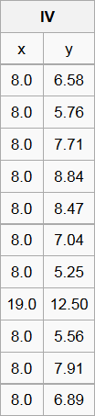
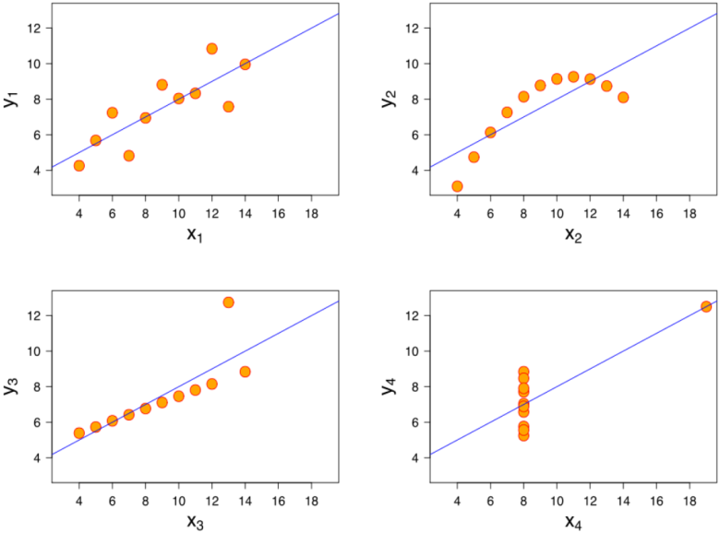
WHY not just use statistics?
Mean(x) = 9.0
Mean(y) = 7.5
Variance(x) = 11.0
Variance(y) = 4.1
Correlation(x,y) = 0.816
Regression line:
y = 3.0 + 0.5x
Source: [Anscombe 1973]
Image Source: Wikipedia

Slide 7
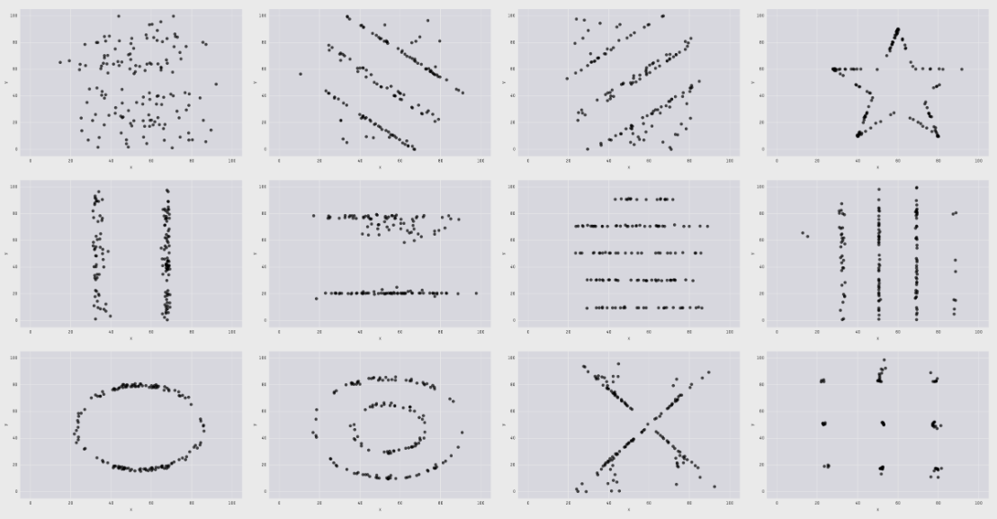
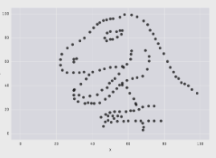
The DATASAUR [CAIRO 2016]
Mean(x) = 54.26
Mean(y) = 47.83
Std. Dev(x) = 16.76
Std. Dev(y) = 26.93
Correlation(x,y) = -0.06

Slide 8

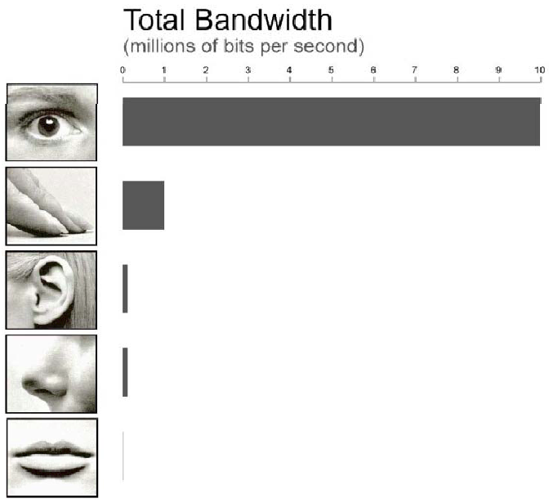
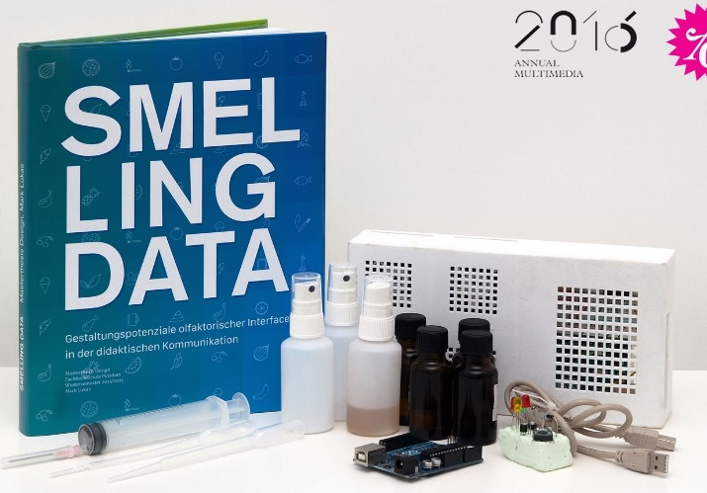

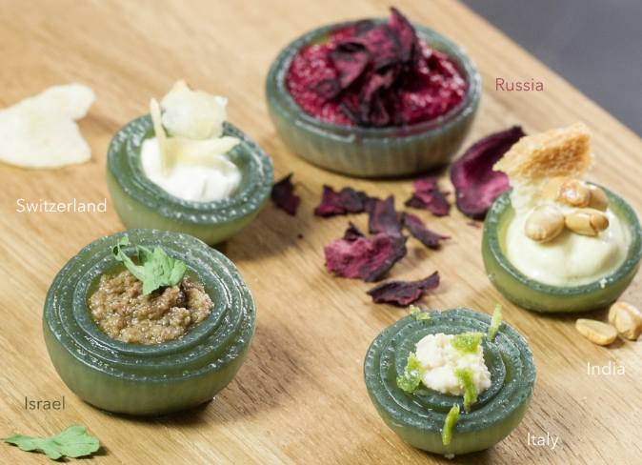
THE COMPETITORS
Haptic Displays – [Leithinger 2010]
Data Sonification
Source: Tor Nørretranders “The User Illusion” (1998)
Olfactoric Interfaces – [Lukas 2015]
Edible Diagrams/Data Dishes – [Himmelspach 2015]

Slide 9
Bad visualizations and how to avoid them

Slide 10
when visualizing data…
…Don’t be stupid!
…Don’t be sloppy!
…Don’t be evil!

Slide 11
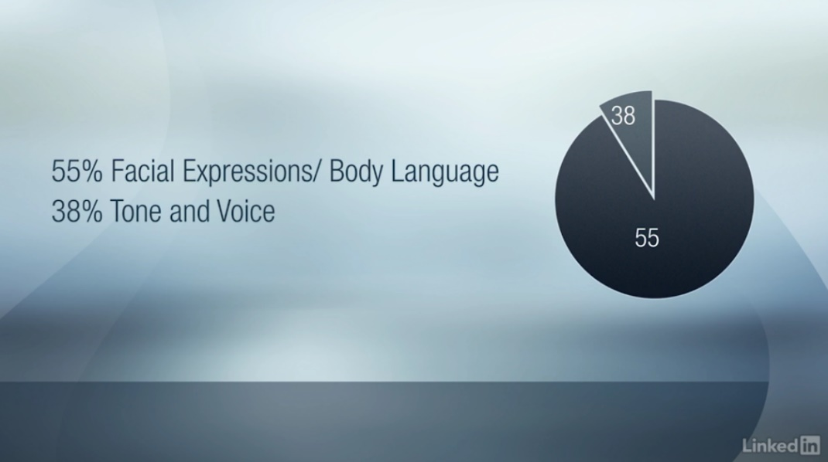
Overall Guideline #1: Don’t be STUPID
Have your pie charts add-up to 100%
Notes:
Opinionated
Form follows function

Slide 12
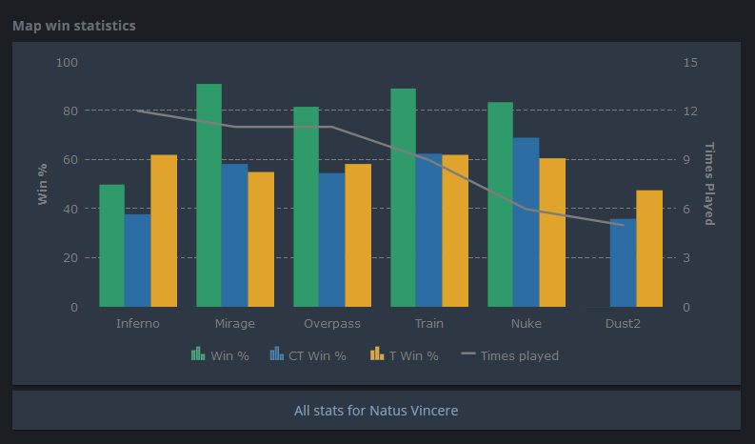
Overall Guideline #1: Don’t be STUPID
Don’t show “trends” over categories
Notes:
Opinionated
Form follows function

Slide 13
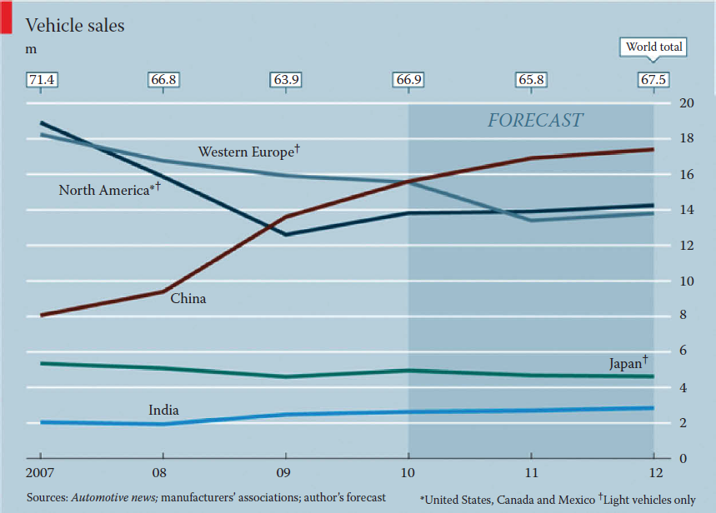
OVERALL GUIDELINE #2: Don’T be sloppy
Ensure the same preprocessing for all data

Slide 14
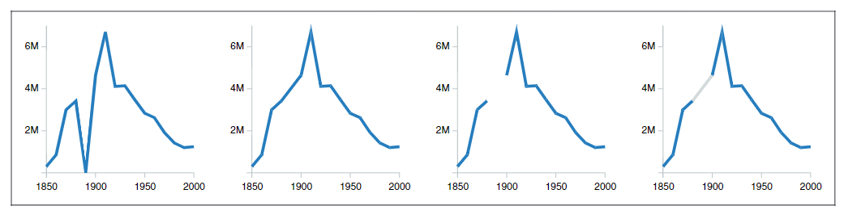
OVERALL GUIDELINE #2: Don’T be sloppy
Number of Farm Laborers in the US, records for 1890 missing due to fire [Source: Kandel 2011]
use placeholder (0) as is
data imputation using linear interpolation
data amputation
data imputation and
explicit encoding
Carefully attend to missing data values

Slide 15
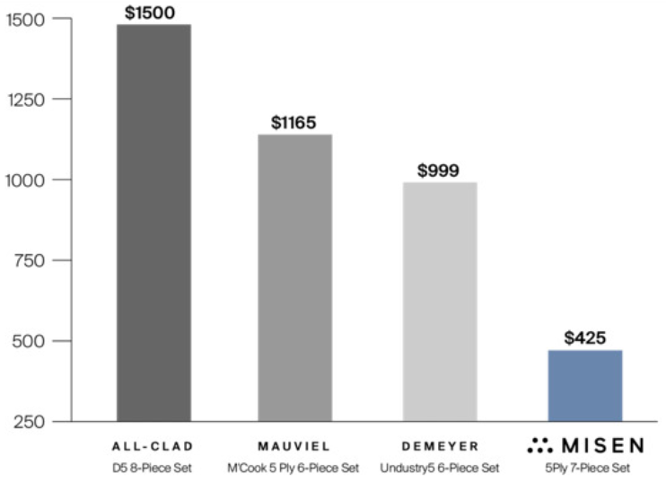
Overall guideline #3: Don’t be evil
Show the full axis for bar charts and line charts

Slide 16
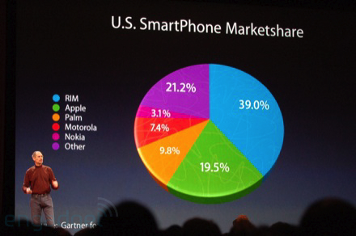
Overall guideline #3: Don’t be evil
Avoid 3D / perspective distortion
Image source: Macworld 2008, engadget.com

Slide 17
Where to learn more about this?
Calling Bullshit – Data Reasoning in a Digital World -> https://callingbullshit.org
Data & Visualization Hazards -> http://visualizingrights.org/kit/hazards/index.html
WTF Visualizations Tumblr -> https://viz.wtf
Reddit Data is Ugly -> https://www.reddit.com/r/dataisugly/
The Economist: “Mistakes, we’ve drawn a few” -> https://medium.economist.com/mistakes-weve-drawn-a-few-8cdd8a42d368

Slide 18
GOOD visualizations and how to MAKE them PART 1: The FundamentalS

Slide 19
The 3 E’S of Data Visualization
Expressiveness := Show the data and only the data.
Effectiveness := Show the data so as to best support the human viewer.
Efficiency := Show the data in a way that balances resource use and chart quality.

Slide 20
Closely MATCH data and VISUALIZATION
Quantitative Data
Qualitative Data
Continuous Data
Discrete Data
Ordinal Data
Categorical Data
Interpolate
✓
Difference
✓
✓
Sort
✓
✓
✓
Match
✓
✓
✓
✓
Adapted from [Stevens 1946] – DOI: 10.1126/science.103.2684.677

Slide 21
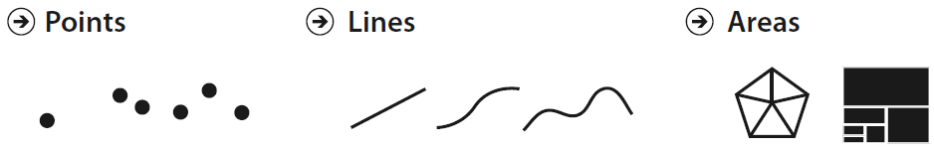
Mapping Fundamentals: Marks
Image source: Munzner 2014

Slide 22
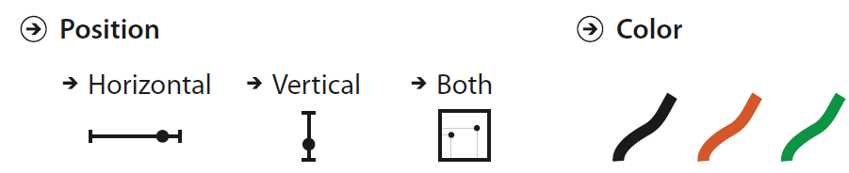
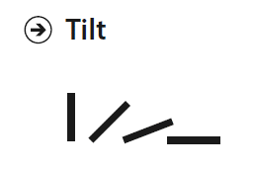

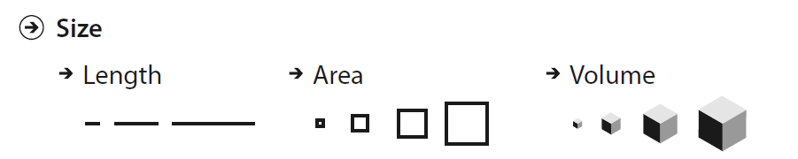
Mapping Fundamentals: Channels
Image source: Munzner 2014

Slide 23
Expressiveness: Match DATA & CHANNEL
categorical data:
ordinal data:
discrete data:
continuous data:
Notes:
Match Data Type & Channel!

Slide 24
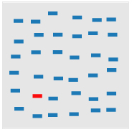
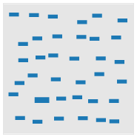
PRECEDENCE among channels
Image source: uxpractical.com
Position
Color
Size

Slide 25
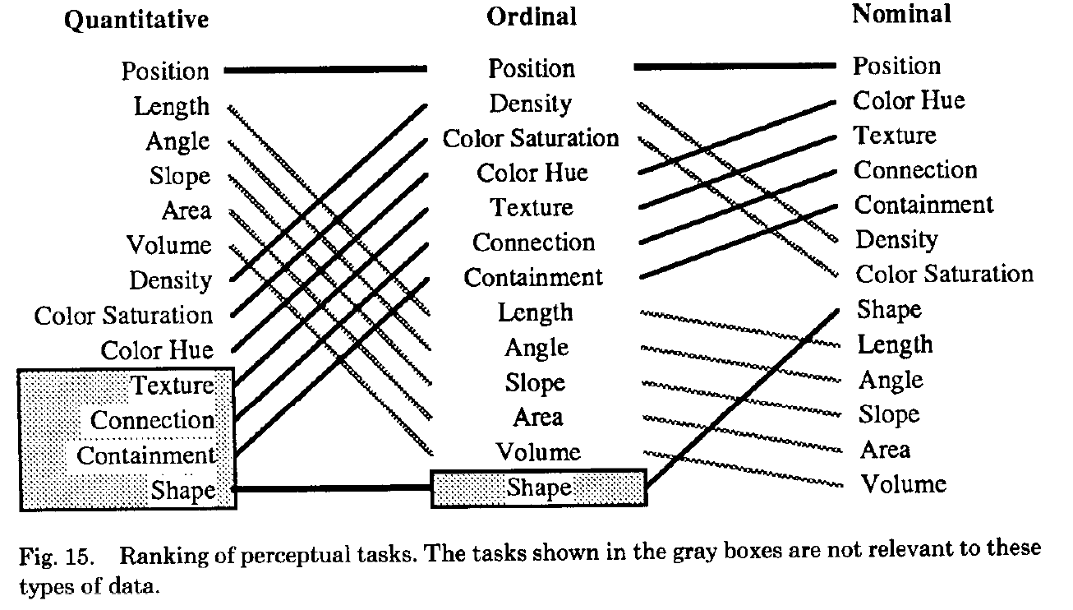
EFFECTIVENESS: MATCH IMPORTANCE & CHANNEL
Image source: Mackinlay 1986

Slide 26
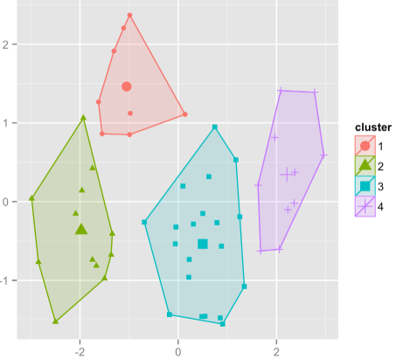
EFFECTIVENESS: USE Multiple channels
What information does this chart want to make sure to get across to the reader?
Notes:
Position, color, shape, enclosure

Slide 27
GOOD visualizations and how to MAKE them PART 2: The charts

Slide 28
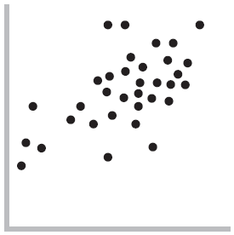
The Scatterplot

Slide 29
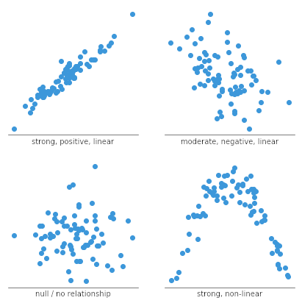
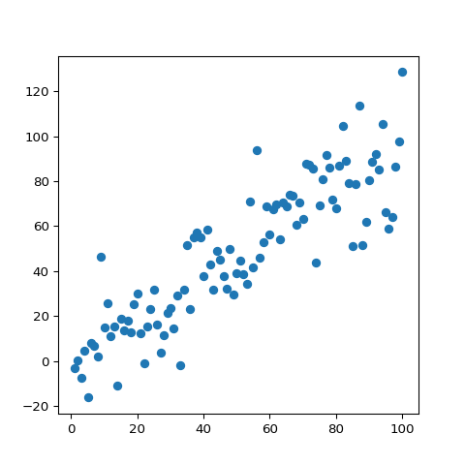
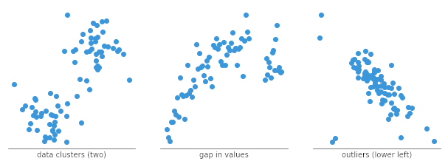
The scatterplot

Slide 30
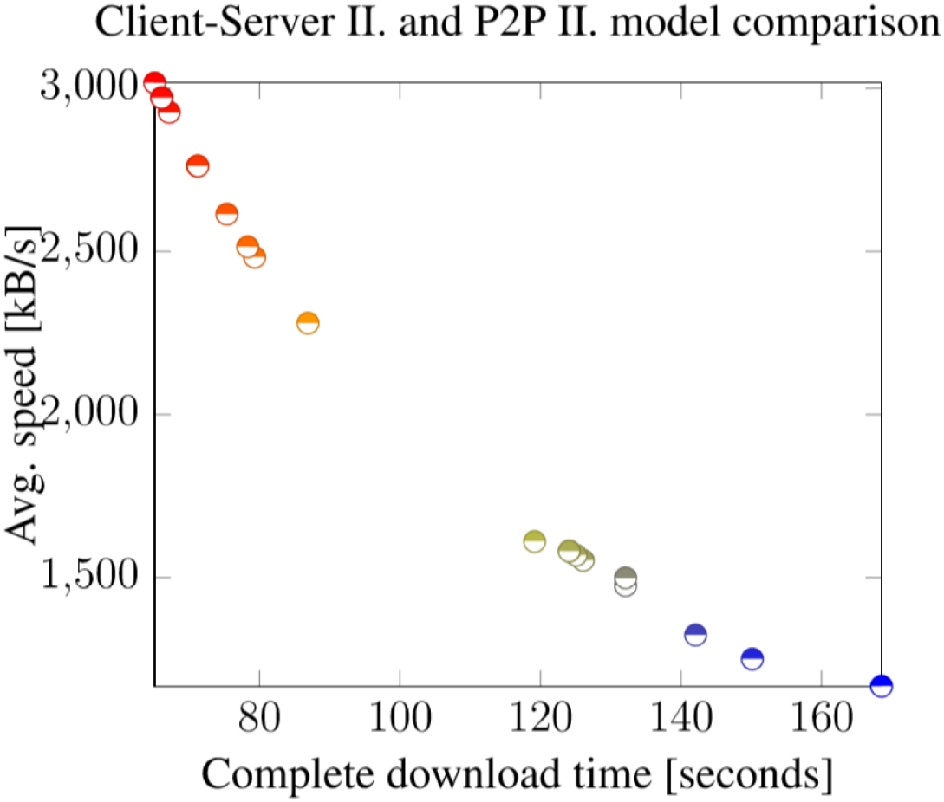
The scatterplot
Considerations:
Does it make sense?

Slide 31
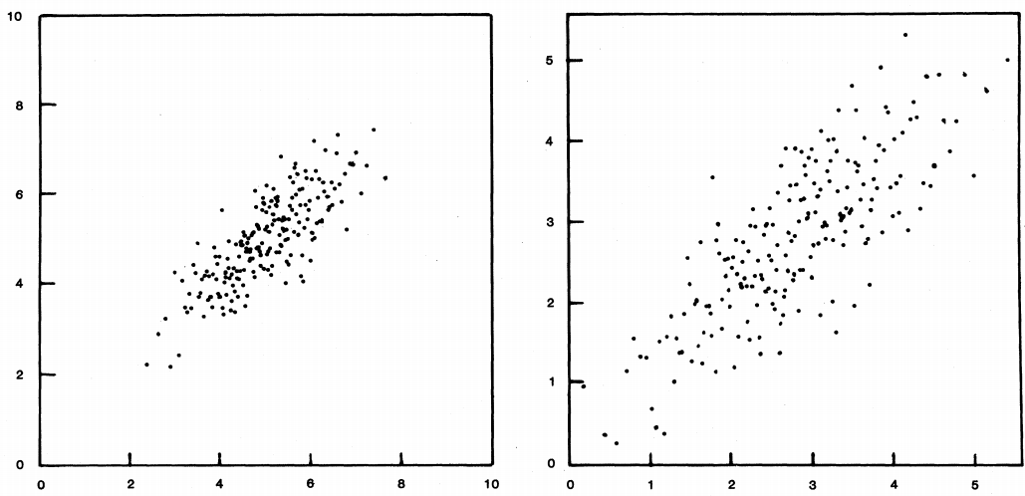
The scatterplot
Considerations:
Does it make sense?
How to scale it?
Image source: doi:10.1126/science.216.4550.1138

Slide 32
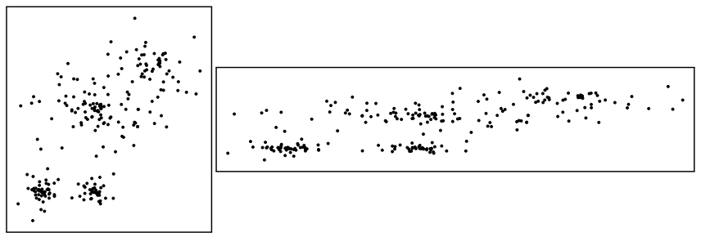
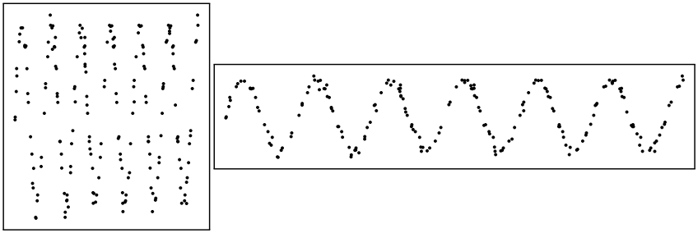
The scatterplot
Considerations:
Does it make sense?
How to scale it?
Which aspect ratio to use?
Image source: doi:10.1109/TVCG.2013.187

Slide 33
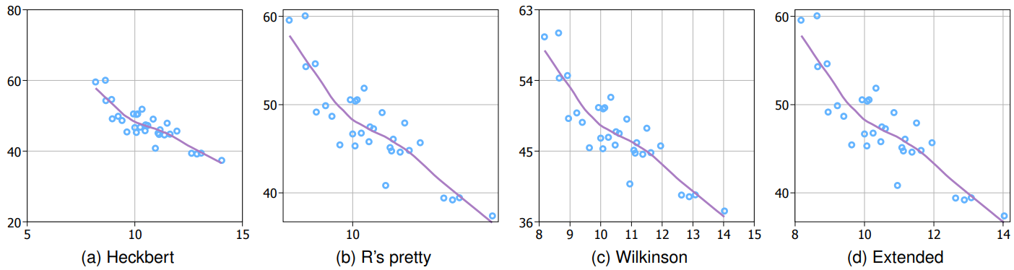
The scatterplot
Considerations:
Does it make sense?
How to scale it?
Which aspect ratio to use?
How to place the tick marks on the axes?

Slide 34
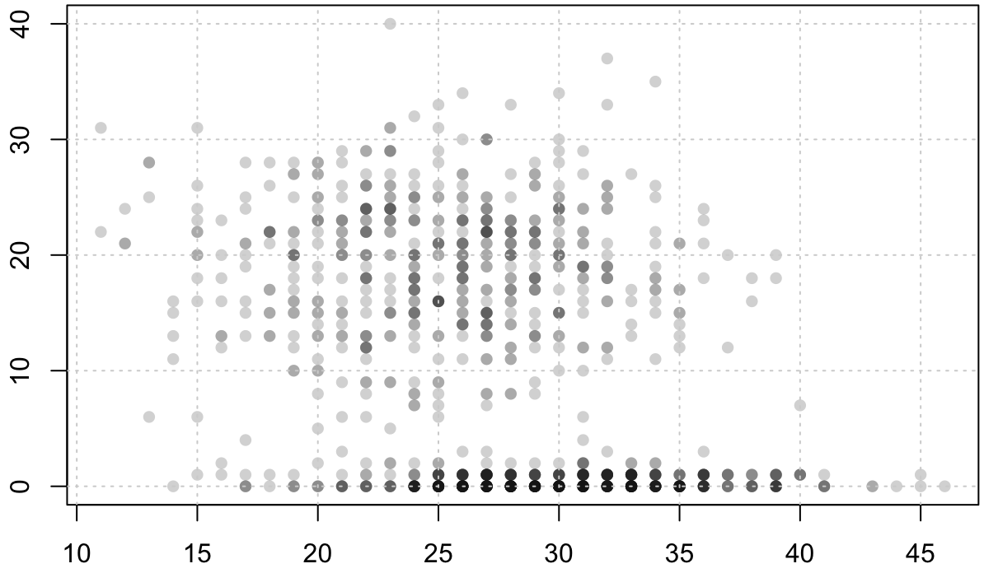
The scatterplot
Considerations:
Does it make sense?
How to scale it?
Which aspect ratio to use?
How to place the tick marks on the axes?
Should I add grid lines in the background?

Slide 35
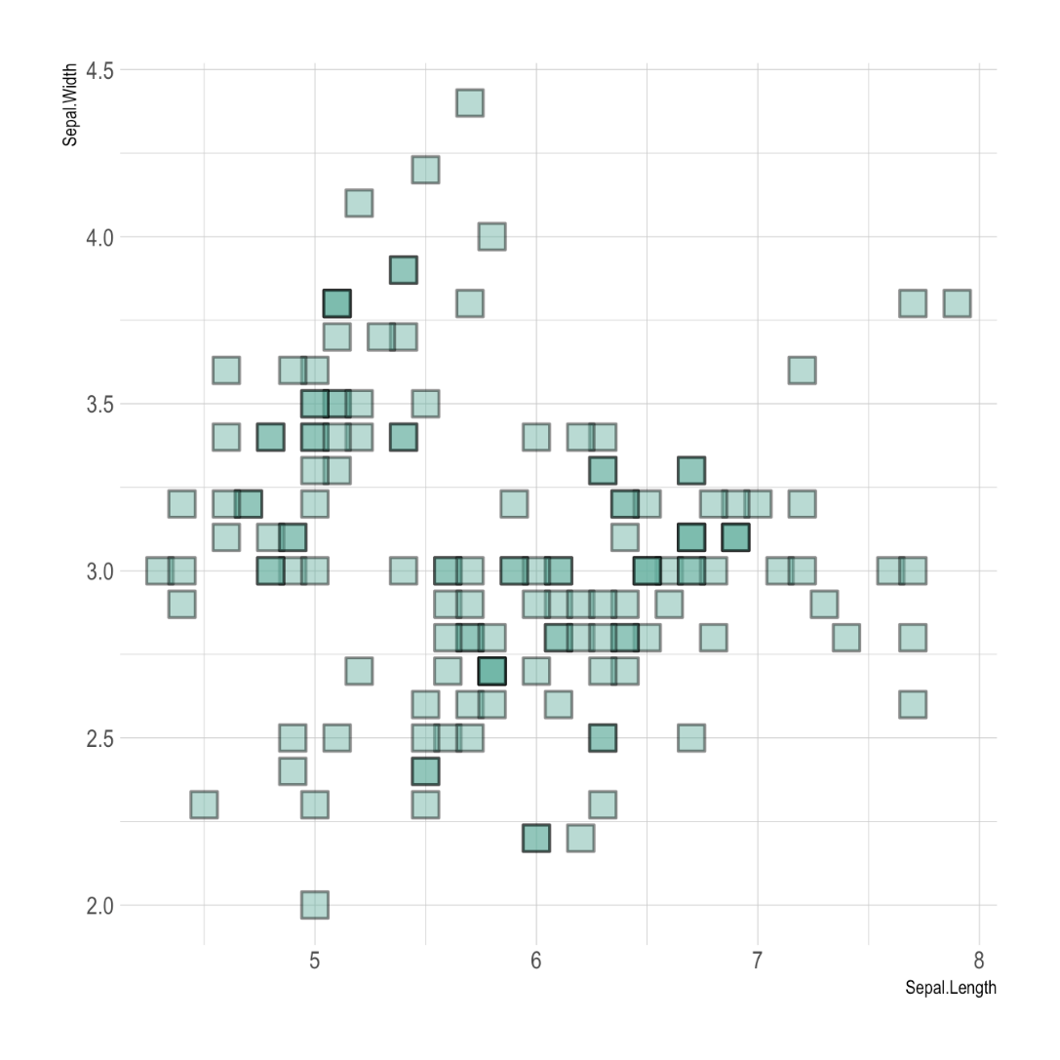
The scatterplot
Considerations:
Does it make sense?
How to scale it?
Which aspect ratio to use?
How to place the tick marks on the axes?
Should I add grid lines in the background?
What shape and size should the dots have?

Slide 36
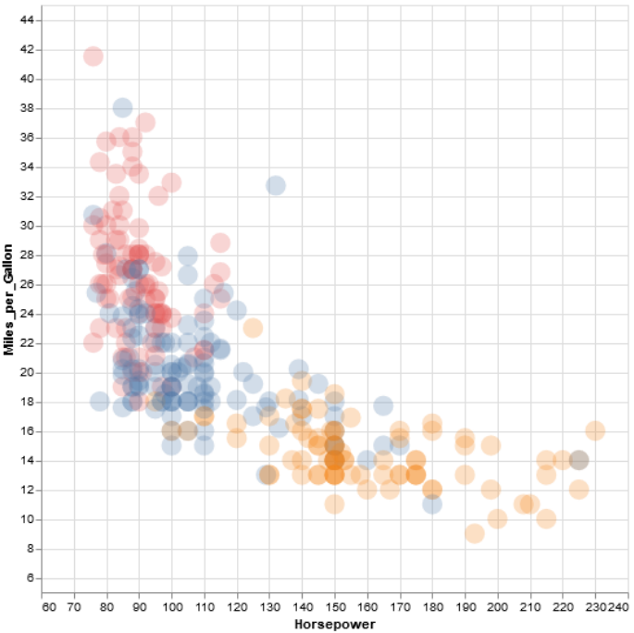
The scatterplot
Considerations:
Does it make sense?
How to scale it?
Which aspect ratio to use?
How to place the tick marks on the axes?
Should I add grid lines in the background?
What shape and size should the dots have?
What color/alpha value should the dots have?

Slide 37
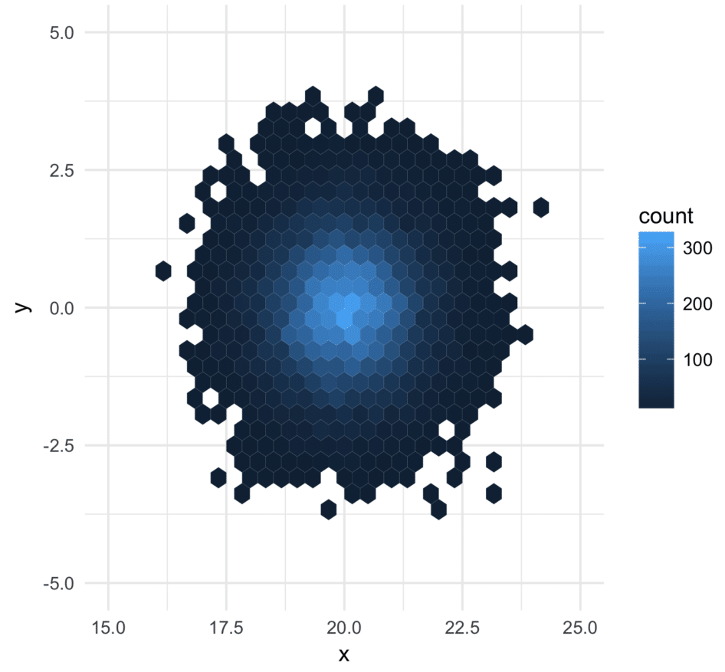
The scatterplot
Considerations:
Does it make sense?
How to scale it?
Which aspect ratio to use?
How to place the tick marks on the axes?
Should I add grid lines in the background?
What shape and size should the dots have?
What color/alpha value should the dots have?
How to deal with overplotting?

Slide 38
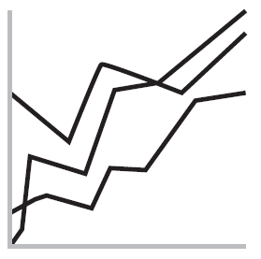
The LINE CHART

Slide 39
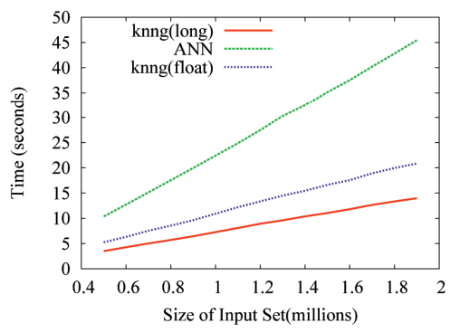
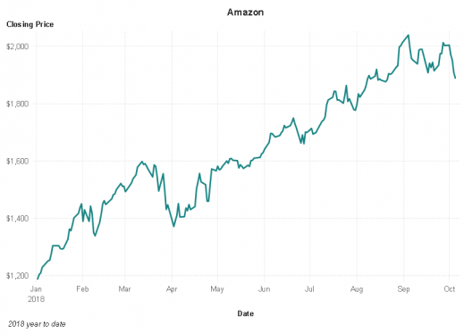
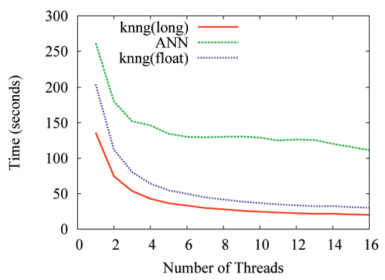
The line chart

Slide 40
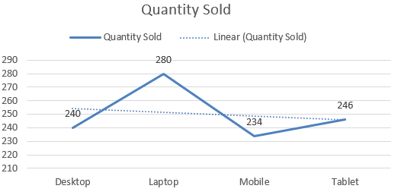
The line chart
Considerations:
Does it make sense?

Slide 41
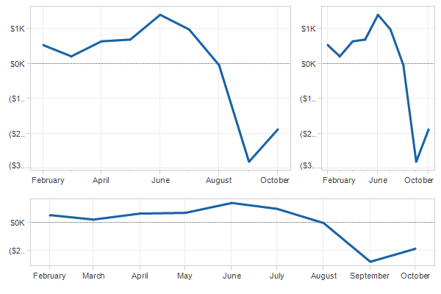
The line chart
Considerations:
Does it make sense?
How to scale it?
45°
Banking to 45°
[Cleveland et al. 1988]

Slide 42
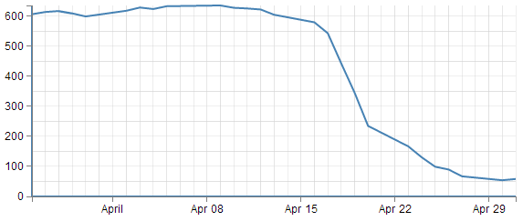
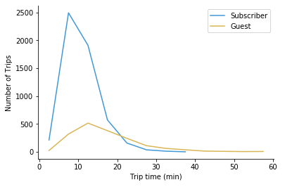
The line chart
Considerations:
Does it make sense?
How to scale it?
Should I use grid lines?

Slide 43
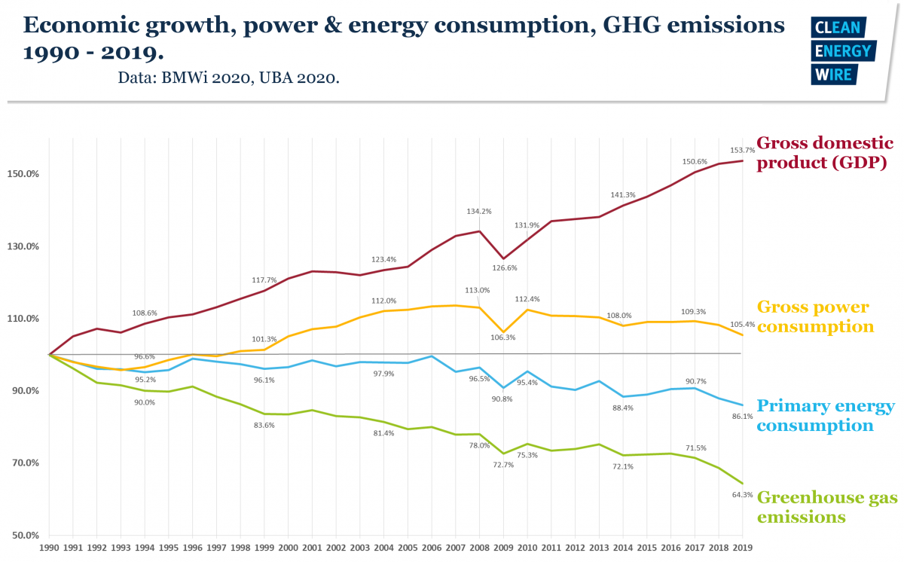

Slide 44
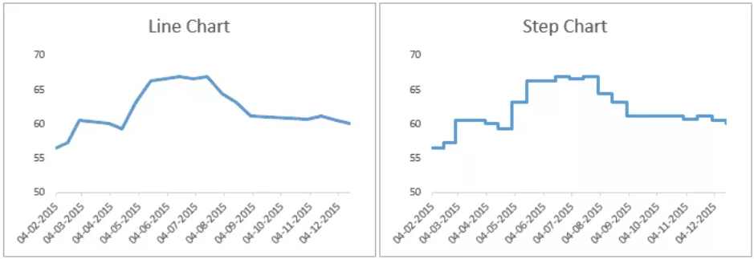

The line chart
Considerations:
Does it make sense?
How to scale it?
Should I use grid lines?
Which line style to use?

Slide 45

The line chart
Considerations:
Does it make sense?
How to scale it?
Should I use grid lines?
Which line style to use?
How to deal with noisy data?
-> Smoothing

Slide 46

The line chart
Considerations:
Does it make sense?
How to scale it?
Should I use grid lines?
Which line style to use?
How to deal with noisy data?
-> Smoothing

Slide 47

Scatterplots vs line charts
Image: 10.1109/TVCG.2017.2653106
Less noise, clear trend => line charts recommended
More noise, unclear trend => scatterplots recommended

Slide 48

The connected scatterplot

Slide 49

The BAR CHART

Slide 50


The bar / column chart
Bar Chart
Column Chart

Slide 51

The bar / column chart
Considerations:
Does it make sense?

Slide 52



The bar / column chart
Considerations:
Does it make sense?
Which aspect ratio to choose? >= 10 : 1
Source: https://www.perceptualedge.com/articles/visual_business_intelligence/bar_widths.pdf
2.5 : 1
10 : 1
30 : 1

Slide 53

The bar / column chart
Considerations:
Does it make sense?
Which aspect ratio to choose?
How far to space the bars? 50%-75%
50%
100%
Source: https://www.perceptualedge.com/articles/visual_business_intelligence/bar_widths.pdf
150%

Slide 54


The bar / column chart
Considerations:
Does it make sense?
Which aspect ratio to choose?
How far to space the bars?
Showing the axes in full

Slide 55


The bar / column chart
Considerations:
Does it make sense?
Which aspect ratio to choose?
How far to space the bars?
Showing the axes in full
Order of the categories

Slide 56

The bar / column chart
Considerations:
Does it make sense?
Which aspect ratio to choose?
How far to space the bars?
Showing the axes in full
Order of the categories
Shape of the bars
Lollipop Chart

Slide 57


The bar / column chart
Considerations:
Does it make sense?
Which aspect ratio to choose?
How far to space the bars?
Showing the axes in full
Order of the categories
Shape of the bars
Color of the bars
Climatology / Meteorology
Accounting / Finance

Slide 58

The histogram is not a bar chart!
Image: 10.1016/j.edurev.2019.100291

Slide 59

The histogram
Considerations:
All of the ones for bar charts (except spacing is often omitted)
Equal bin sizes

Slide 60

The histogram
Considerations:
All of the ones for bar charts (except spacing is often omitted)
Equal bin sizes
Adequate number of bins

Slide 61

The histogram

Slide 62
Other chart types

Slide 63

Visualization Techniques for Hierarchical Data – http://treevis.net

Slide 64

Visualization Techniques for Textual Data – http://textvis.lnu.se

Slide 65

Visualization Techniques for Financial Data – http://financevis.net

Slide 66

Visualization Techniques for Multifaceted Scientific Data – http://multivis.net

Slide 67

Visualization Techniques for Temporal Data – http://timeviz.net -> Browser

Slide 68
How to create such visualizations?

Slide 69




CODING VISUALIZATIONS W/ VEGA LITE
Altair
Vega-Lite
Reactive Vega
D3 Kernel
Python wrapper for Vega-Lite → NumPy, Pandas -> https://altair-viz.github.io
abstraction of Vega, less flexible, but more concise -> https://vega.github.io/vega-lite/
still highly customizable, but declarative -> https://vega.github.io/vega/
ultimate degree of customization -> https://d3js.org

Slide 70






Vega-lite EXAMPLES

Slide 71
Interactive notebooks vega-lite
Disclaimer: Some notebooks are adapted from tutorials on Vega-Lite's website
https://tinyurl.com/tutorial-vl
Other notebooks of interest:
Introduction to Vega-Lite API https://observablehq.com/@uwdata/introduction-to-vega-lite
DAVI - VEGA Tutorial https://observablehq.com/collection/@mahog/davi-vega-tutorial
DAVI – D3 Tutorial https://observablehq.com/collection/@mahog/davi-d3-tutorial
Observable: The User Manual https://observablehq.com/@observablehq/user-manual
Notes:
https://tinyurl.com/tutorial-vl
https://tinyurl.com/tutorial-v
https://tinyurl.com/tutorial-d3

Slide 72



RECOMMENDED BOOKS
Tamara Munzner: Visualization Analysis and Design
Christian Tominski, Heidrun Schumann: Interactive Visual Data Analysis
Robert Spence: Information Visualization. An Introduction, 3rd Edition

